Slide 1
Azure Backup and Site Recovery

Slide 2
Introduction
You can use Azure to backup and restore your application whether in the cloud or on-premises any enterprise.
Azure offers different options to help depending on the type of backup.
Azure Backup, backs up data from on-premises servers running Windows Server into the cloud.

Slide 3
Azure Backup
Azure Backup is a service provided by Microsoft Azure to back up and restore our data over the Microsoft cloud.
Azure Backup replaces our existing on-premises or off-site backup solution with a cloud-based solution that is reliable, secure, and cost-competitive.
Azure backup works with this heterogeneous storage environment with the combination of on-premises storage and also cloud storage.
Whenever Azure backup uses local storage, we'll not get charged for it. You will only get charged when the data is backed up in the cloud.

Slide 4
Advantages of Azure Backup
Automatic storage management
Unlimited scaling
Multiple Storage options
Application consistent backup
Long-Term retention

Slide 5
Site Recovery
Azure Site Recovery (formerly Hyper-V Recovery Manager) can help you protect important applications by coordinating the replication and recovery of Hyper-V images across sites.
You can back up to your own secondary site, a hoster's site, or use Azure and avoid the expense and complexity of building and managing your own secondary location.
Azure encrypts data and communications and you have the option enable encryption for data at-rest too.
It monitors the health of your services continuously and helps automate the orderly recovery of services in the event of a site outage at the primary datacenter.
Virtual machines can be brought up in an orchestrated fashion to help restore service quickly, even for complex multi-tier workloads.

Slide 6
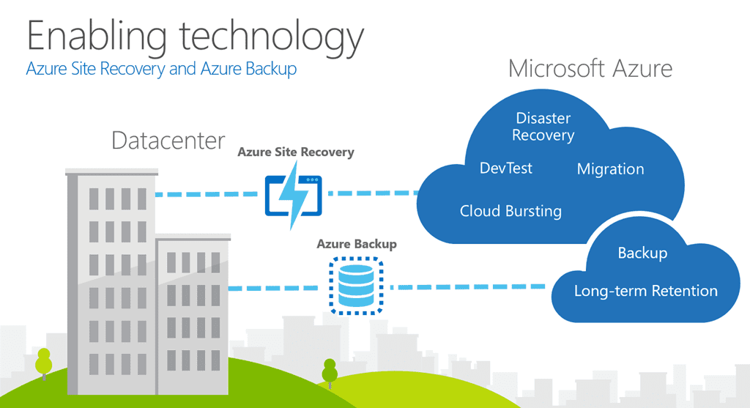

Slide 7
You can manage your backups directly from the backup tools in Windows Server 2012, Windows Server 2012 Essentials, or System Center 2012 - Data Protection Manager.
Alternatively, you can use a specialized backup agent.
Data is safer because backups are encrypted before transmission and stored encrypted in Azure and protected by a certificate that you upload.
The service uses the same redundant and highly available data protection found in Azure Storage.

Slide 8
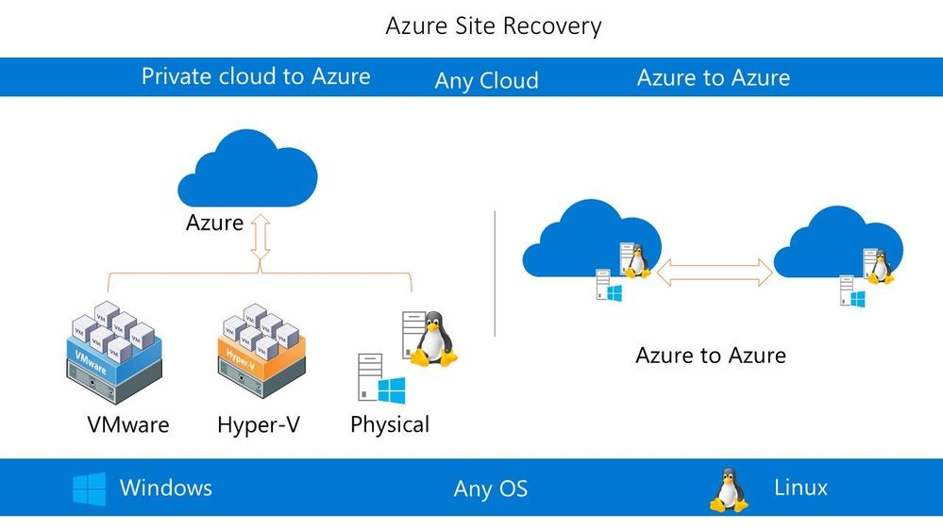

Slide 9
You can back up files and folders on a regular schedule or immediately, running either full or incremental backups.
After data is backed up to the cloud, authorized users can easily recover backups to any server.
It also offers configurable data retention policies, data compression, and data transfer throttling so you can manage the cost to store and transfer data.

Slide 10
Using Site Recovery, you can set up and manage replication, failover, and failback from a single location in the Azure portal.
You can set up disaster recovery of Azure VMs from a primary region to a secondary region or from Azure Public MEC to the Azure region or from one Azure Public MEC to another Azure Public MEC connected to the same Azure region.
You can replicate VMware VMs to Azure using the improved Azure Site Recovery replication appliance that offers better security and resilience than the configuration server.

